Slide 1
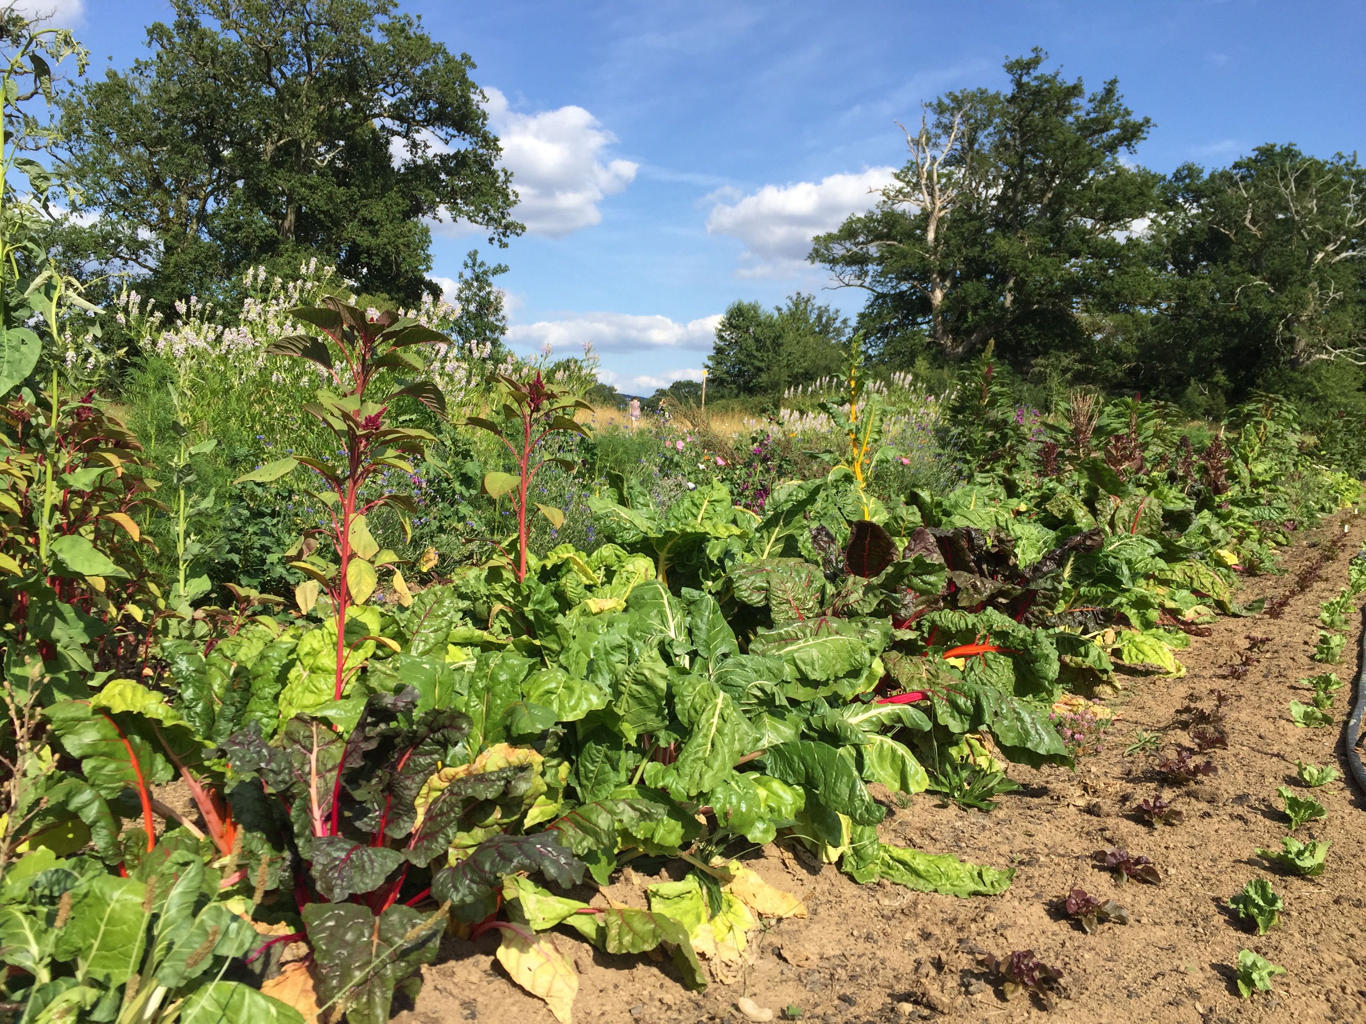
Welcome at Chez Mà Healthy ready-made components for meals-on-wheels

Slide 2





Challenge of our target clients
Chez Mà
Needs
Not able or willing to cook
Environmentally conscious
Self-reliant
Healthy eating habits
Limited choice of food selection
Cathrine, (49)
On diet with broken leg
Sabine, (35) mom with a her first new-born child
Klaus, (55)
On convalenscence after heavy cancer-surgery
Monica, (77) On convalence after spine-operation

Slide 3
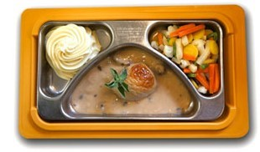
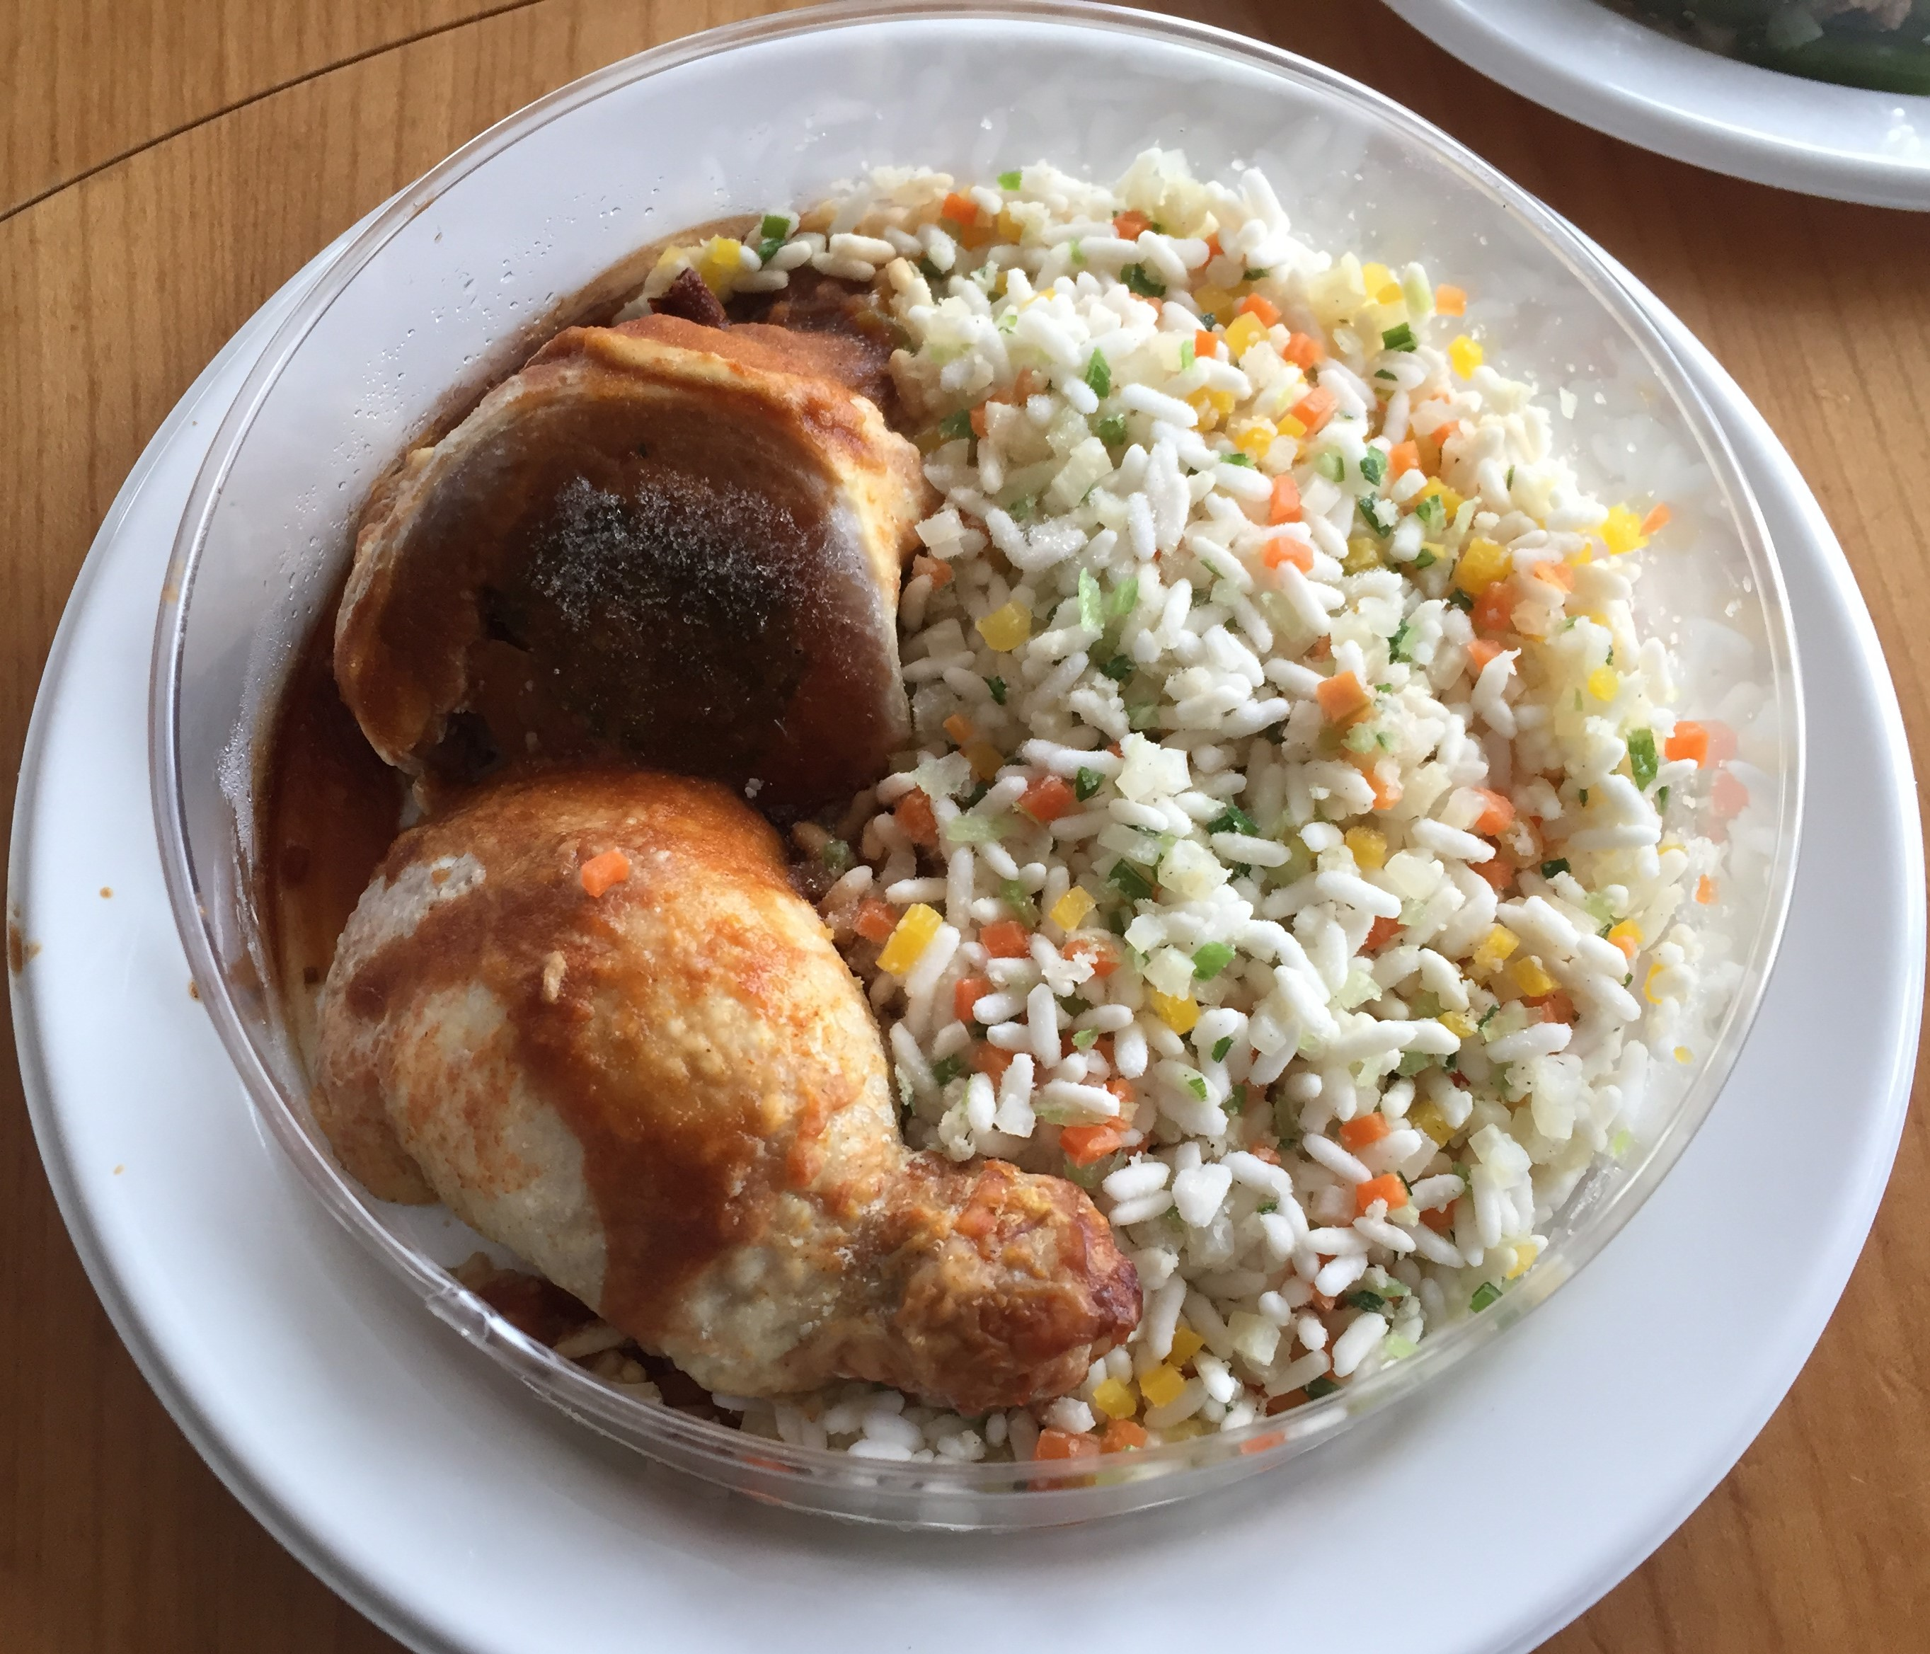
Existing offers on the market
Chez Mà

Slide 4
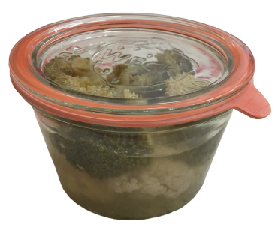
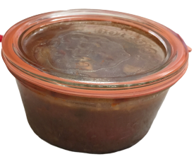
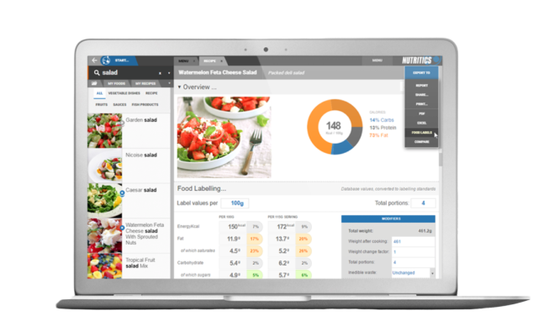
Chez Mà ‘s USP
Chez Mà
+
+

Slide 5
Compliant to 7 out of 17 UN’s Sustainable development goals and global health
Chez Mà
Chez Mà

Slide 6
Landing Page

Slide 7
Übersicht Komponenten/Menu

Slide 8
Selektion Komponenten

Slide 9
Rating der Komponenten

Slide 10
Profile

Slide 11
Summary

Slide 12
Order

Slide 13
Challenges
Chez Mà
External services with different ingredient Ids
Unsuccessful API access
Different databases and recipes based on countries

Slide 14
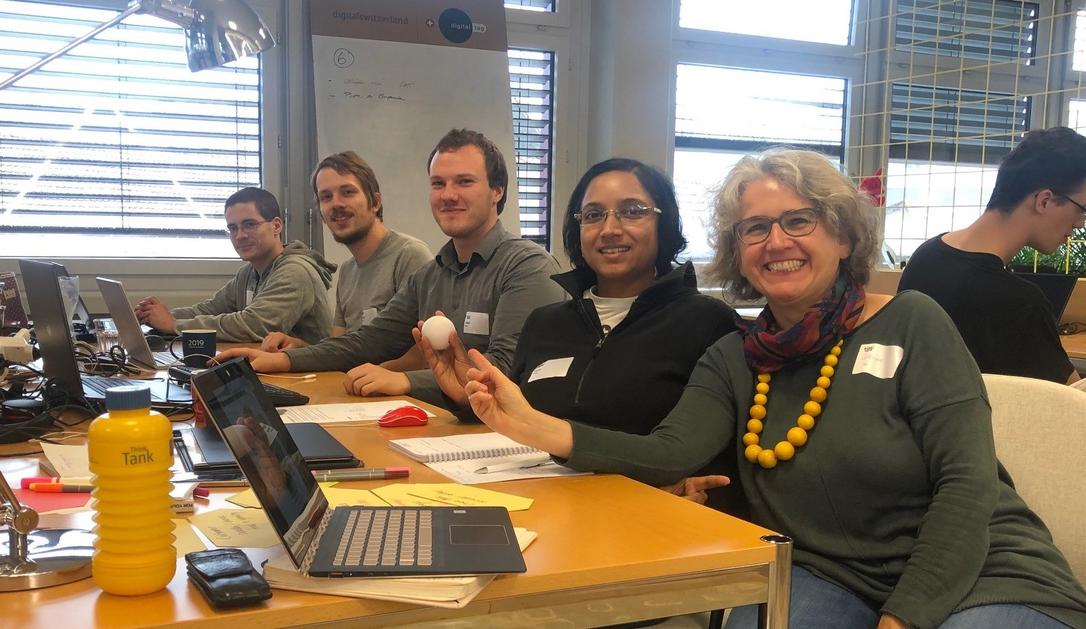
Hope you liked it…. Your Chez Mà -Team!
Tobias, Patrick, Olli, Jane und Cathrine

Slide 15
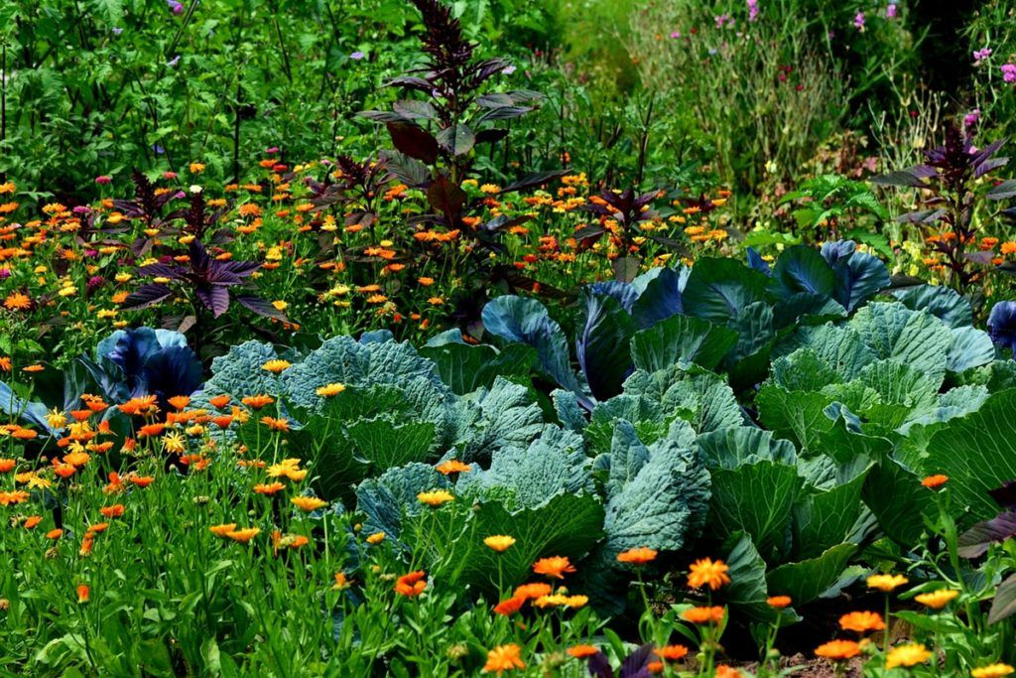
Our Offer: Like out of Grandma’s garden
No more fixed menues!
Individual components to be chosen of
No more industrial production!
Seasonally and locally produced
Transparency regarding sustainable impact and nutrional value
No more packaging nightmare!
zero plastic and reusable packaging

Slide 16
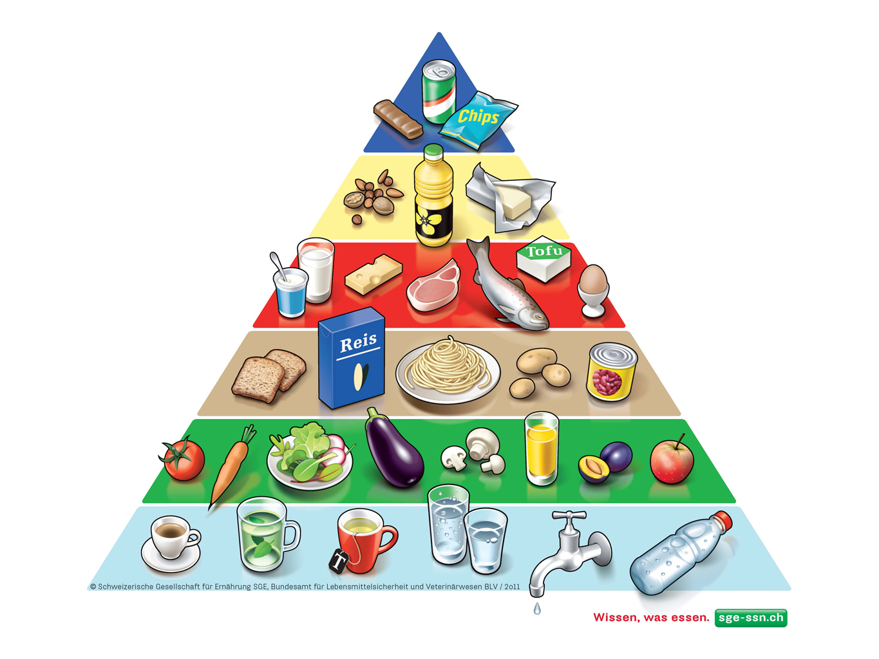
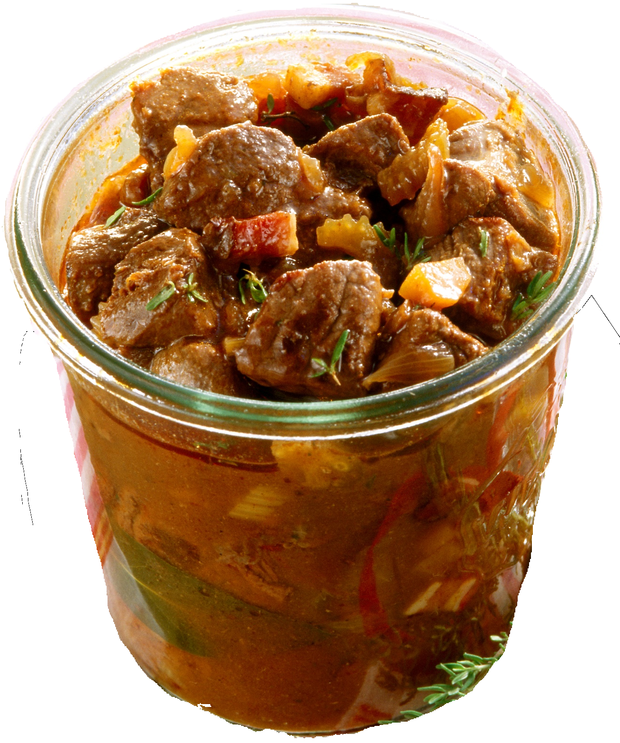

Combination of environmental foodprint with individualized health information
Chez Mà

Slide 17
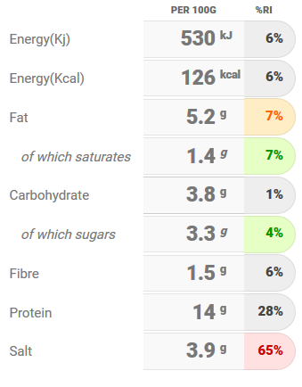


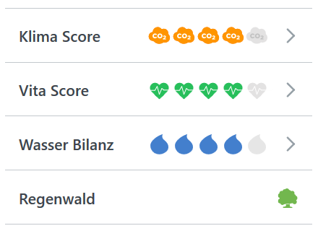

Our offer for Monica
Chez Mà
Nutritional rating:
Monica, 77 years old
Health profile (for example diabetic)
Environmental rating:
Beef goulash
ca. 15 CHF

Slide 18
Compliant to 7 out of 17 UN’s Sustainable development goals and global health
Chez Mà
Chez Mà
Chez Mà

Slide 19
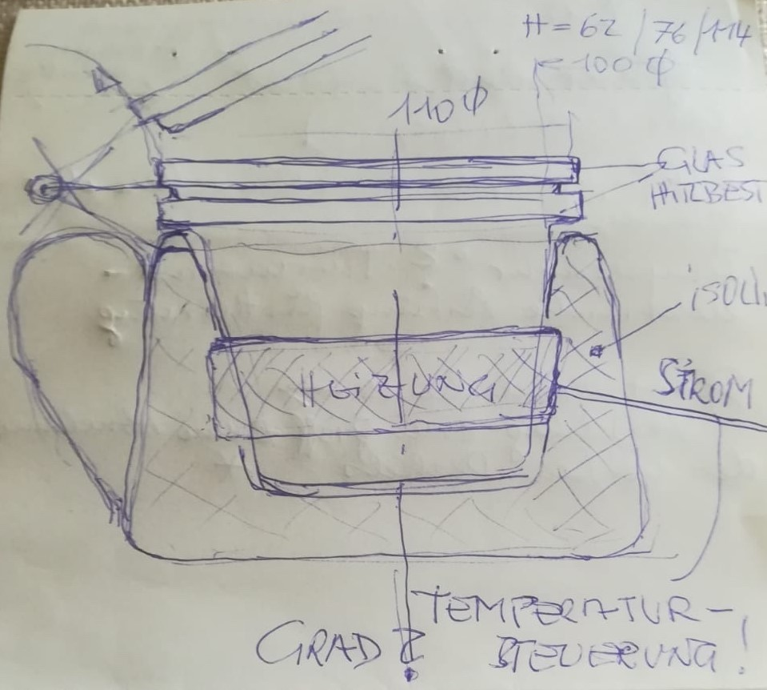
Energy reduction
Water reduction
Chez Mà
Chez Mà

Slide 20






Rely on existing solutions
Efficiency in distribution chanel
Ambassadors
Chez Mà
Chez Mà

Slide 21
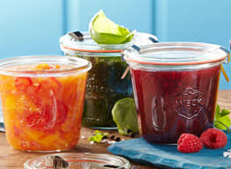
Traditional canning
Regional and seasonal production
Chez Mà
Chez Mà
Inclusion of saved food
Reduction of storage engergy
Reduction of energy used for production

Slide 22

Component based food offer
Chez Mà
Chez Mà
Reduction of food waste at home

